Slide 1

Machine learning applied to time series

Slide 2
Objectives
Understand how machine learning applied to time series
Examples of Machine learning applied to time series
Machine learning applied to time series

Slide 3
ML applied to time series
What types of things can we do with machine learning over time series?
→ Student discuss and give opinions
Machine learning applied to time series

Slide 4
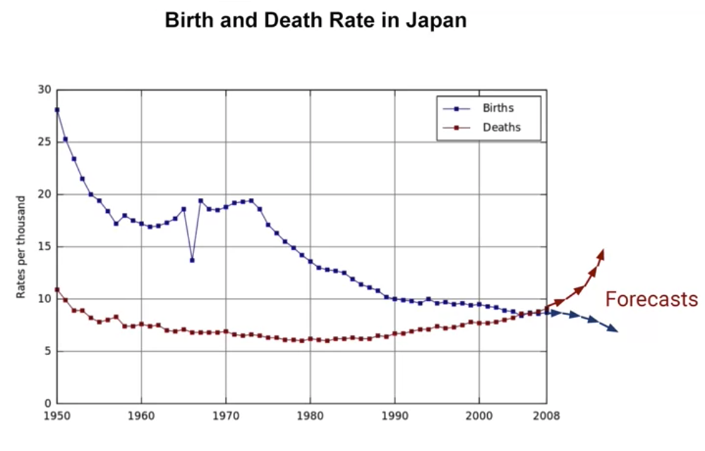
ML applied to time series
Prediction of forecasting
Machine learning applied to time series

Slide 5
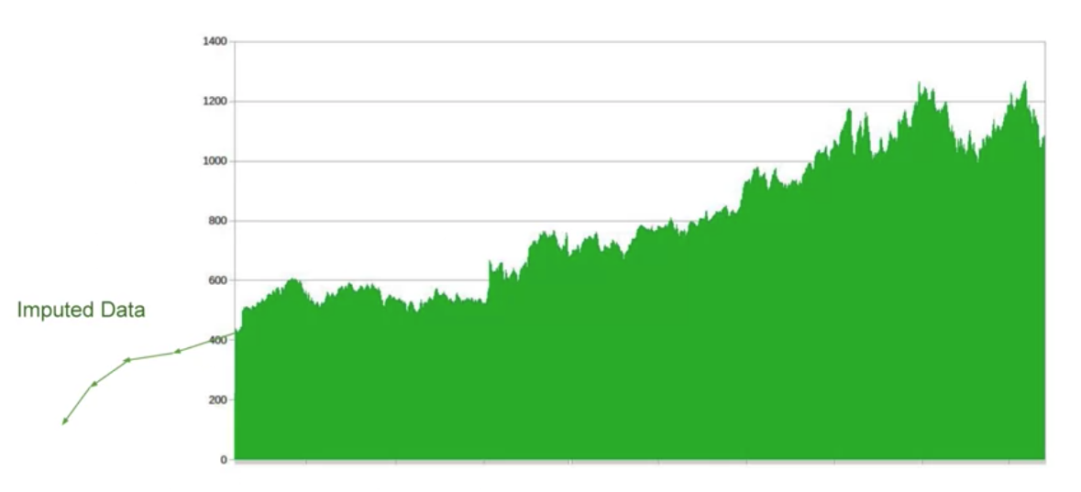
ML applied to time series
To project back into the past to see how we got to where we are now.
Machine learning applied to time series

Slide 6
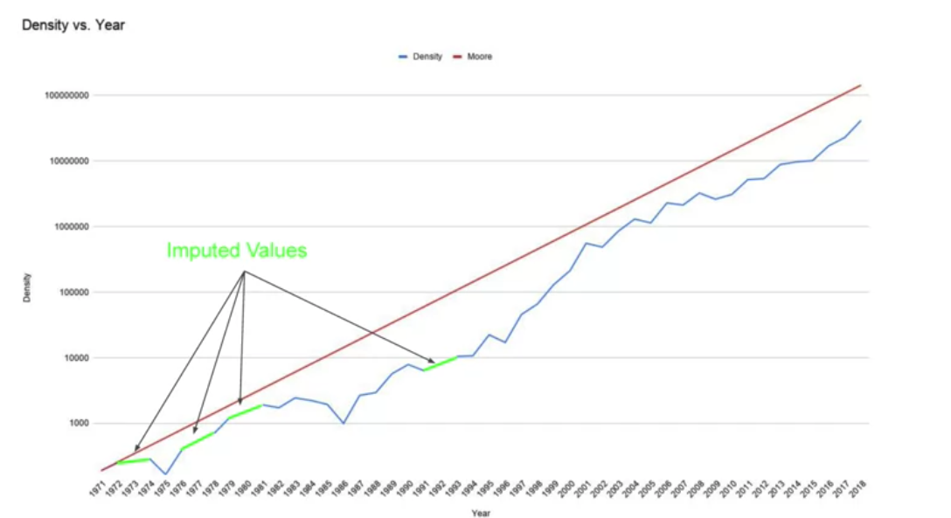
ML applied to time series
To fill in holes in your data for what data doesn't already exist
Machine learning applied to time series

Slide 7
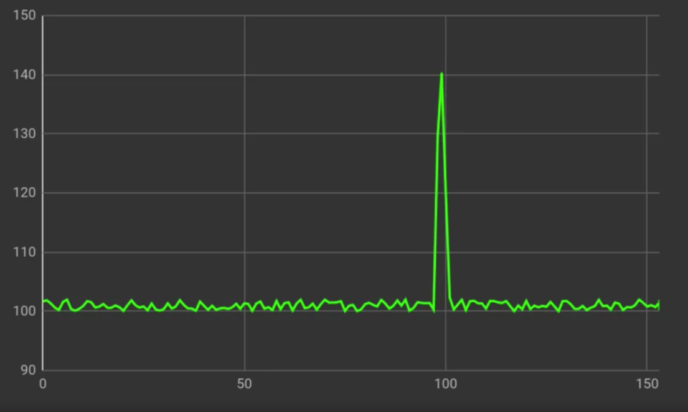
ML applied to time series
To detect anomalies
Machine learning applied to time series

Slide 8
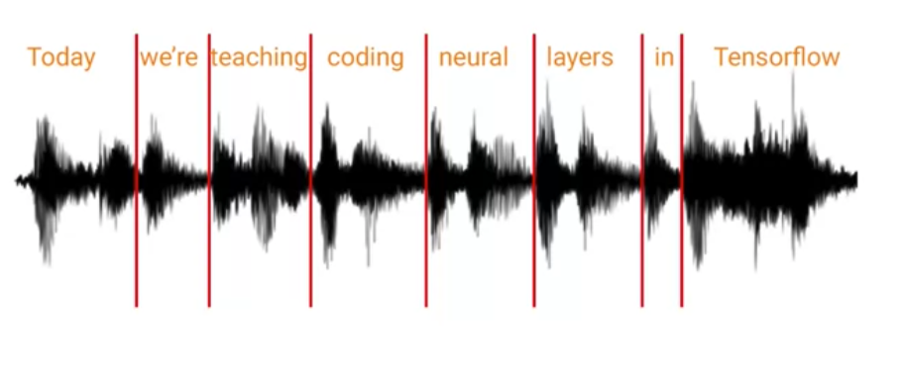
ML applied to time series
To analyze sound waves to spot words in them which can be used as a neural network for speech recognition
Machine learning applied to time series

Slide 9
ML applied to time series
Machine Learning Classification Models:
  For example, classifying whether a patient's vital signs indicate a particular medical condition or predicting the occurrence of an event based on time-dependent features.
Support Vector Machines (SVM) and Support Vector Regression (SVR):
  Can be applied to time series data for classification and regression tasks. They work by finding a hyperplane that separates classes or predicts target values based on input features.
Machine learning applied to time series

Slide 10
ML applied to time series
Ensemble Models:
  Combining multiple models into an ensemble can enhance predictive performance. Techniques like bagging (e.g., Random Forests) and boosting (e.g., AdaBoost, XGBoost) can be applied to time series forecasting.
Feature Engineering:
  Extracting relevant features from time series data is crucial for machine learning models. This can include statistical measures, time-domain features, frequency-domain features, and other engineered representations of the data.
Machine learning applied to time series

Slide 11
ML applied to time series
Transfer Learning:
  Transfer learning techniques, where a model trained on one time series dataset is fine-tuned for another related dataset, can be applied to leverage knowledge learned from one domain to another.
Hyperparameter Tuning and Cross-Validation:
  Like in other machine learning applications, hyperparameter tuning and cross-validation are essential for optimizing model performance on time series data.
Machine learning applied to time series

Slide 12
ML applied to time series
Machine Learning Regression Models:
  Algorithms like linear regression, decision trees, random forests, and gradient boosting can be trained to predict future values based on historical time series data.
Machine learning applied to time series

Slide 13
Summary
Understand how machine learning applied to time series
Examples of Machine learning applied to time series
Machine learning applied to time series

Slide 14
Q & A
Machine learning applied to time series

